Slide 1



Smart Water Management

Slide 2
Problem statement:
Problem Solution:
Water is a major resource of our day to day lives. Since, most of the people has no idea or any awareness about the water management. In order to save the water , we have to learn how to manage the water.
In both domestic and commercial usage, manipulation on the water is essential to avoid the lavishness of water. By this management system, water level would be monitor at any time by the user and also they can analyze the data of the water usage.
Prototype:

Slide 3
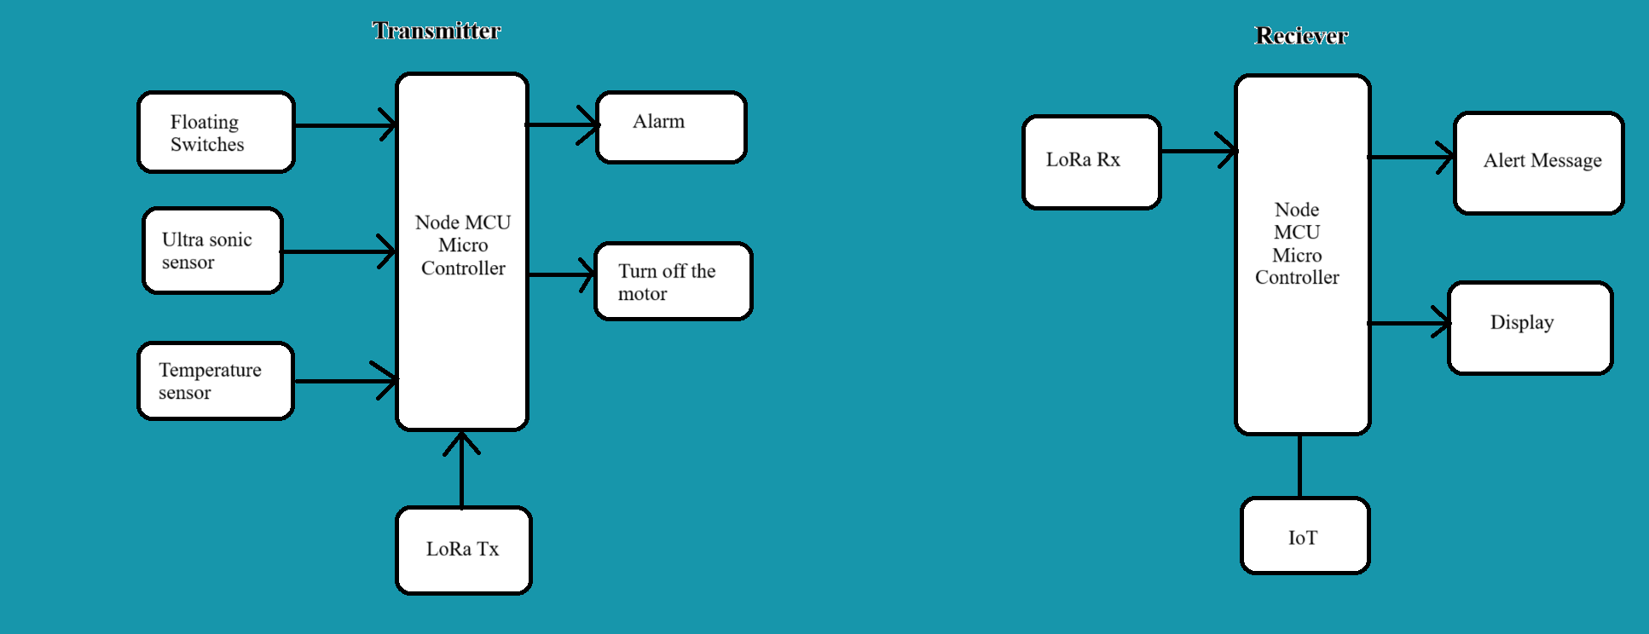
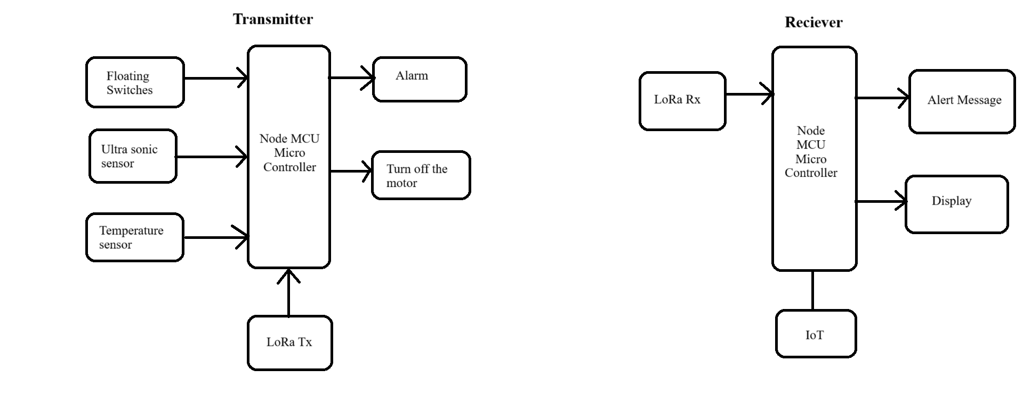
Methodology:

Slide 4
Working Principle:
Water level is continuously monitored by the user with the help of Ultra Sonic sensor.
When the tank has been filled , it will be detected by Floating Switches sensor. Due to this alarm will be triggered and also the micro controller turns off the motor to avoid the water flow.
In this system, user can analyse the data of their day to day life’s water usage .
By using the LoRa network ,the alert message would be passed to the user, when the water level is low.
And also can monitor the temperature of the water with the help of temperature sensor.

Slide 5

By this idea approach , we are concluding that conservation of water would be enhanced and there will be no lavishness usage of water. So that we can able to save the water and it is cost effective system.
THANK YOU

